Slide 1
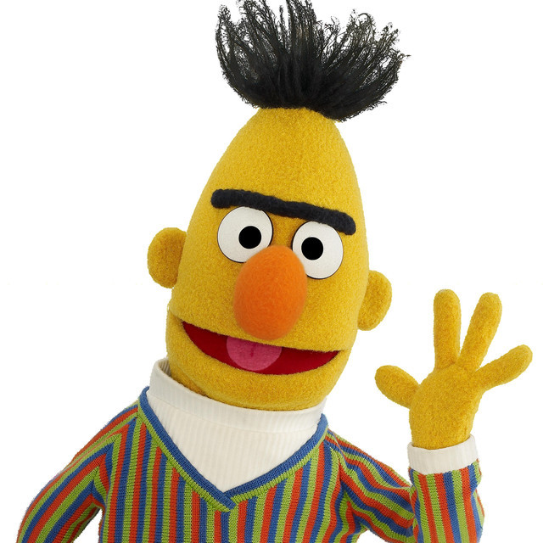
Memorisation versus Generalisation in Pre-trained Language Models

Slide 2
Introduciton
This paper explores BERT's learning dynamics and its impact on generalization and memorization.
BERT shows strong generalization abilities but struggles in few-shot scenarios with class imbalances.
The authors propose ProtoBERT, an improved model with prototypical networks, to overcome these challenges.
The study experiments with high label noise and low label frequency, revealing new insights.

Slide 3
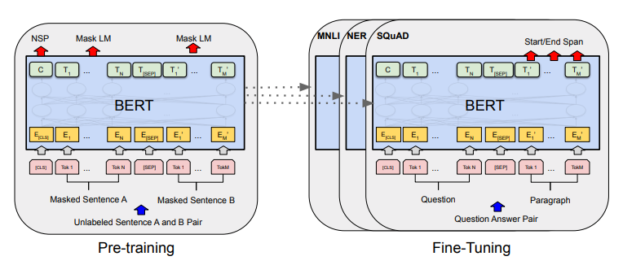
The main language model used in the experiments was BERT-base, augmented with a classification feed-forward layer. The model was fine-tuned using cross-entropy loss and trained with specific hyperparameters. The study also compared the behavior of BERT with other pre-trained transformers like RoBERTa and DeBERTa, as well as a bi-LSTM-CRF model with combined character-level and word-level representations.

Slide 4
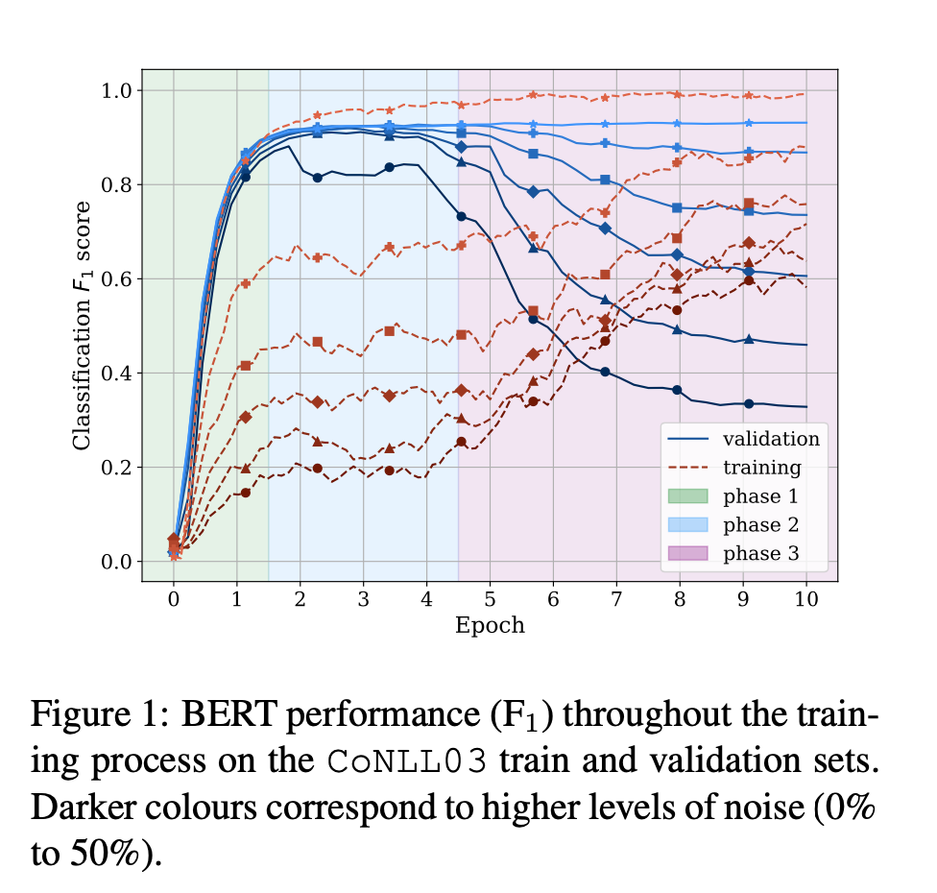
Generalization in noisy setting

Slide 5
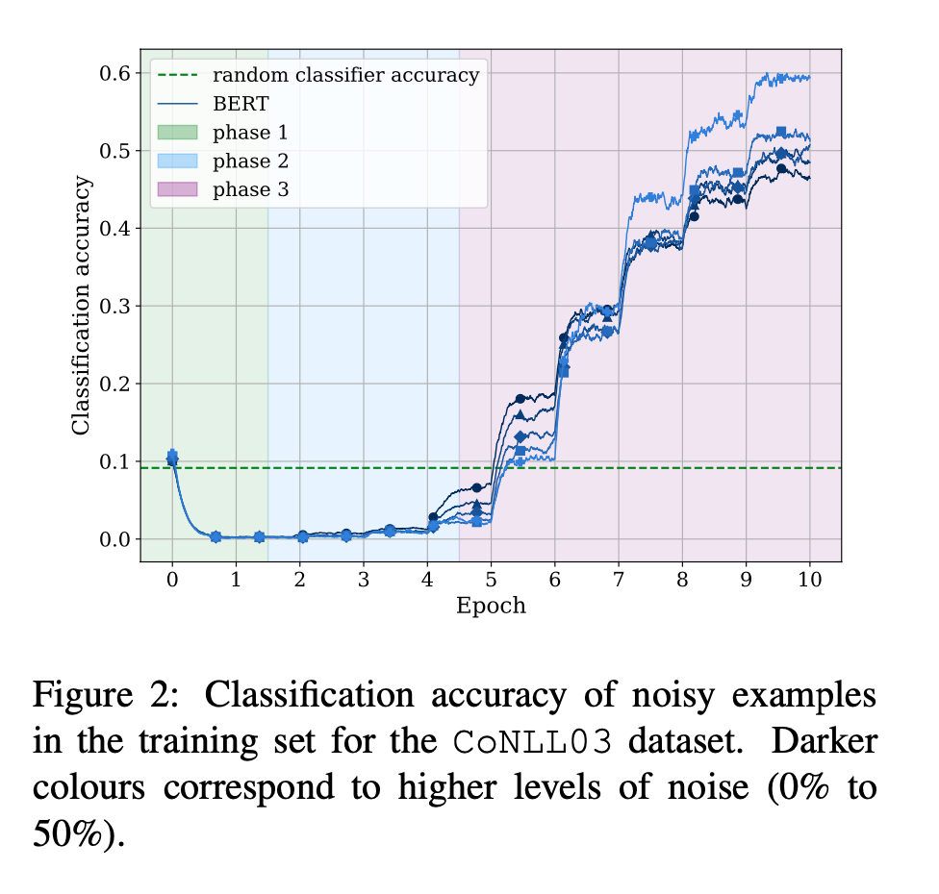
Generalization in noisy setting

Slide 6
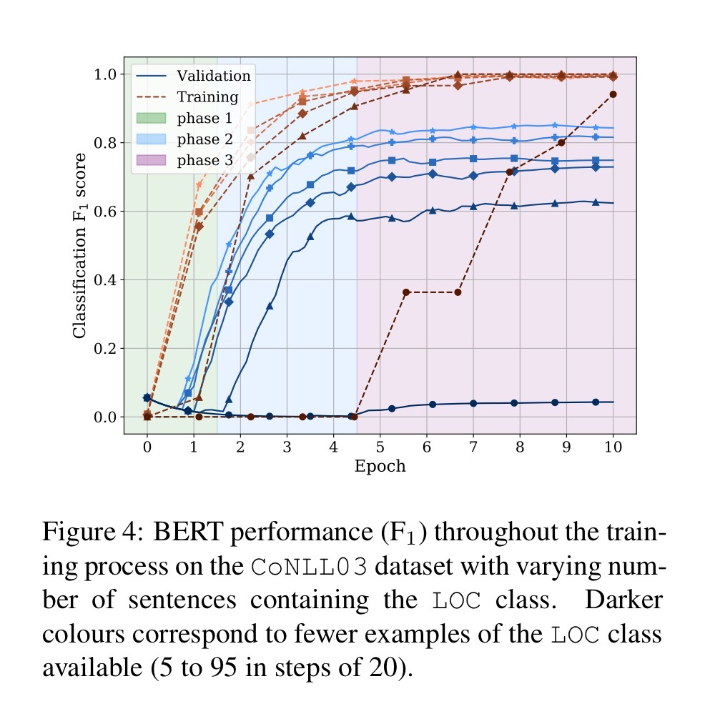
BERT in low-resources scenarios
Reducing the number of sentences containing a class, greatly reduce the model's ability to generalise but not training performance
When fewer sentences are available they tend to be learned in earlier epochs.
With CoNLL03 dataset, Bert need at least 25 example of a minority label to start learning it and plateaus at 100

Slide 7
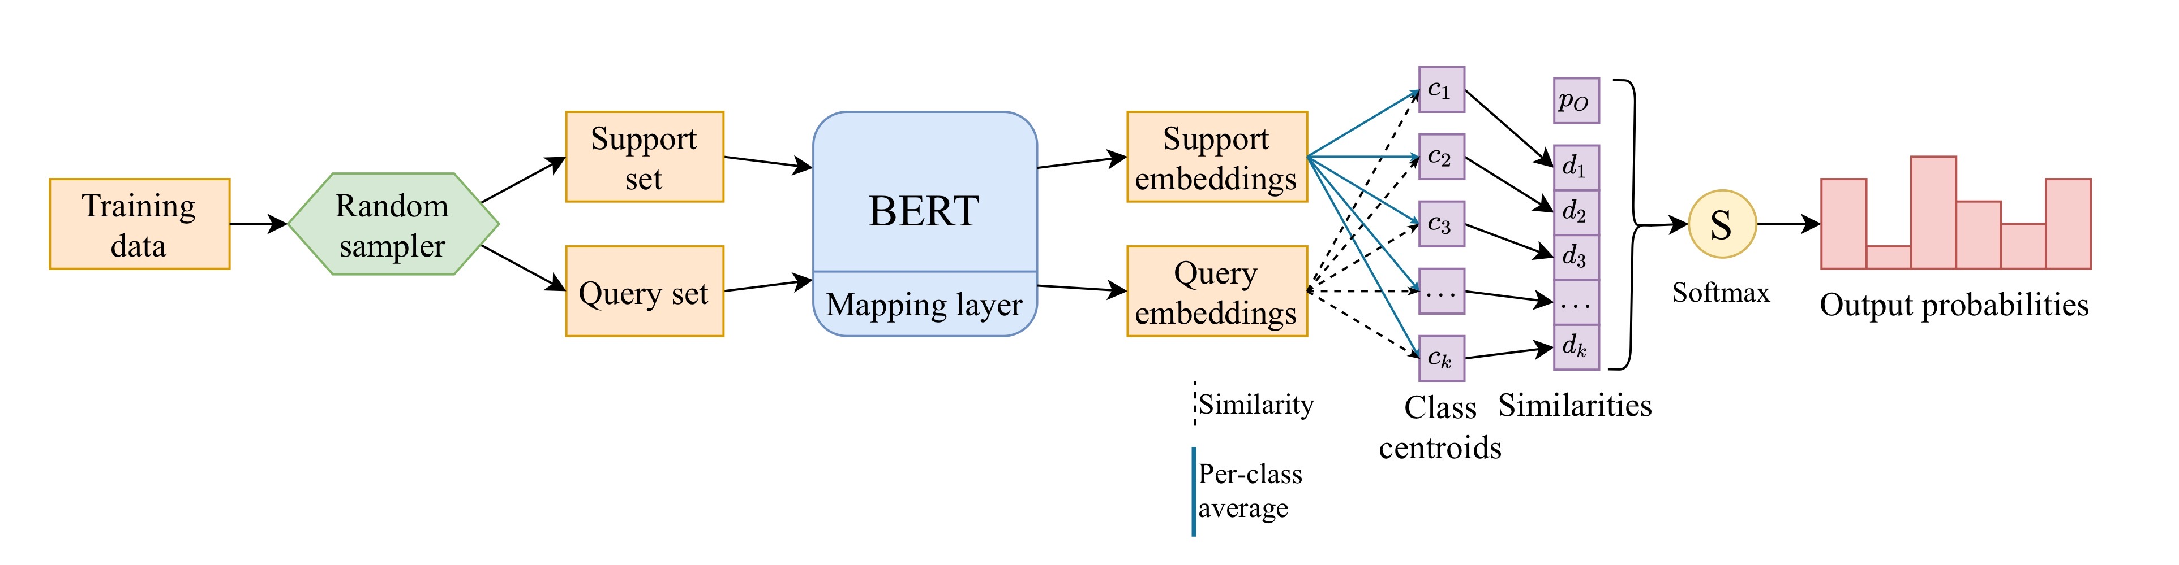
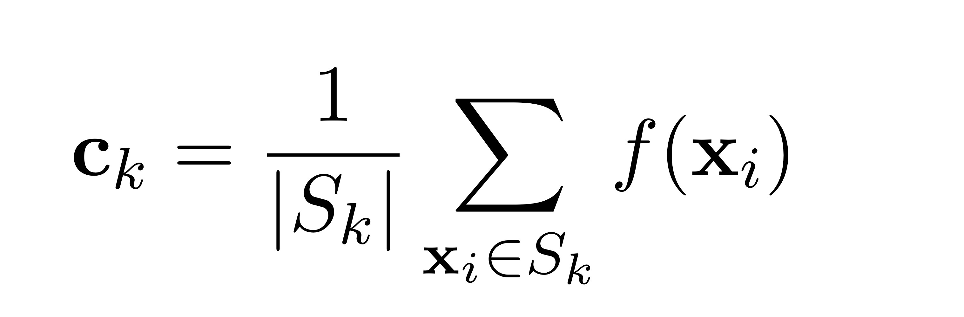
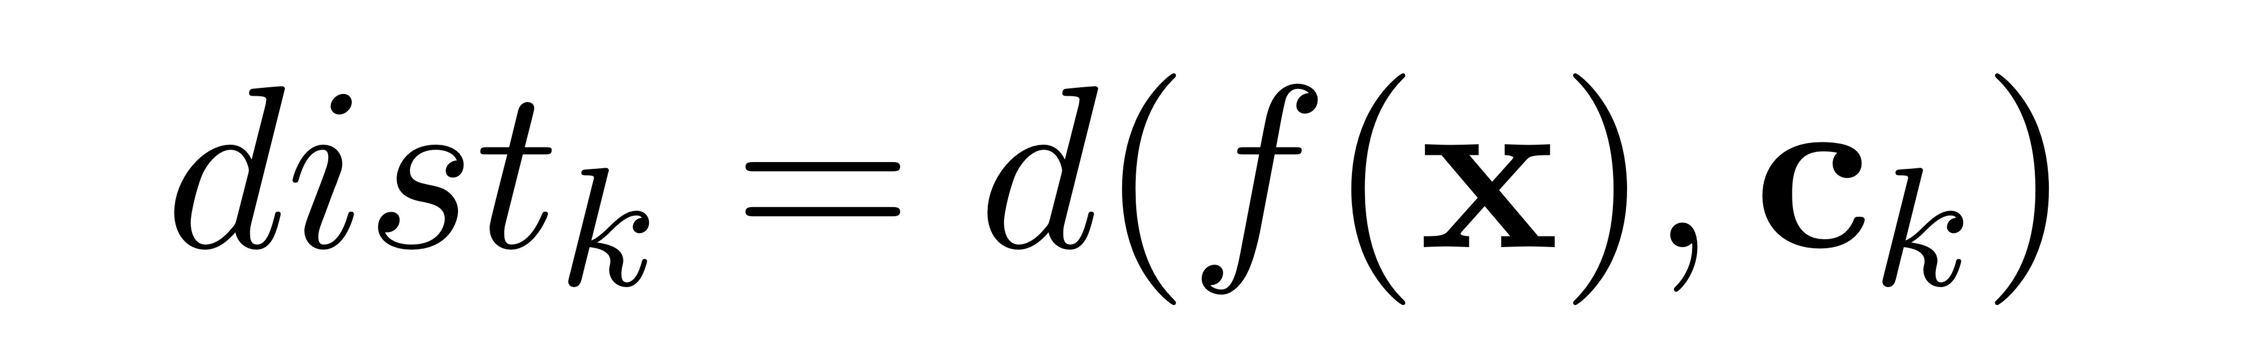
ProtoBert for few-shot learning:
Augment Bert with a prototypical layer
Centroids:
Support and query set change at each iteration
Euclidean's distance as similarity measure:

Slide 8
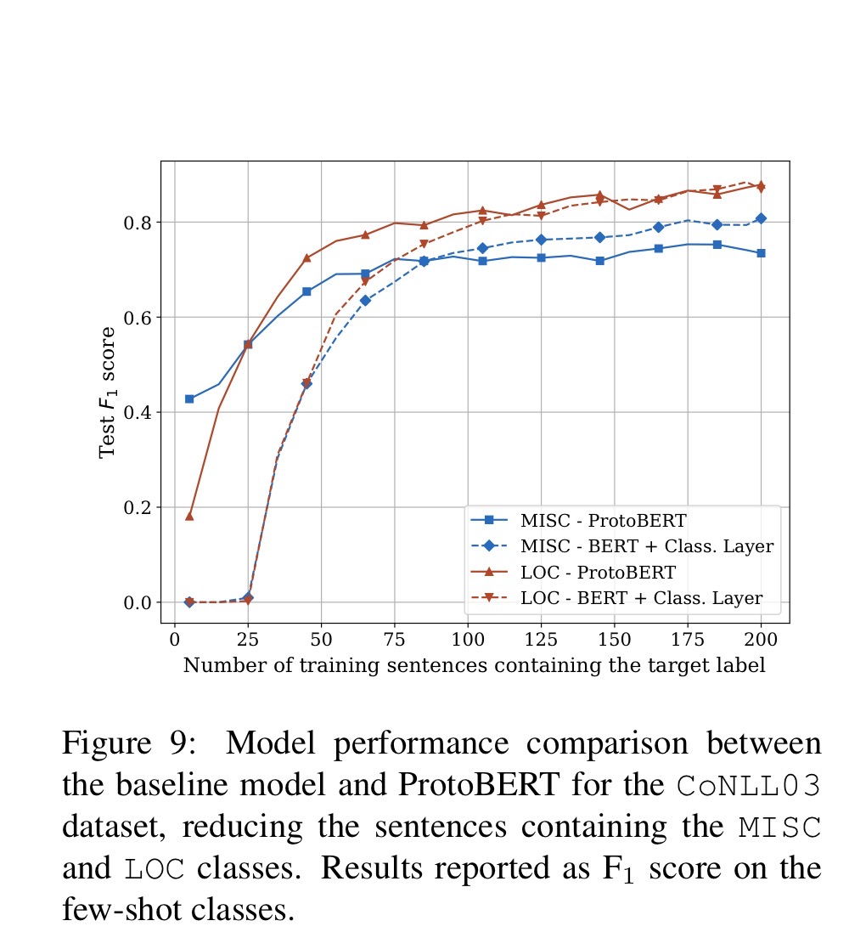
Results:
In presence of only few example of a class, ProtoBert consistently surpasses the performance of baseline Bert, in particular when in presence of extreme few-shot settings.
As the minority class example increase BERT start to match ProtoBert's performance and in some cases surpass it.
ProtoBERT perform similarly to BERT also in task without extreme few-shot scenarios

